Slide 1
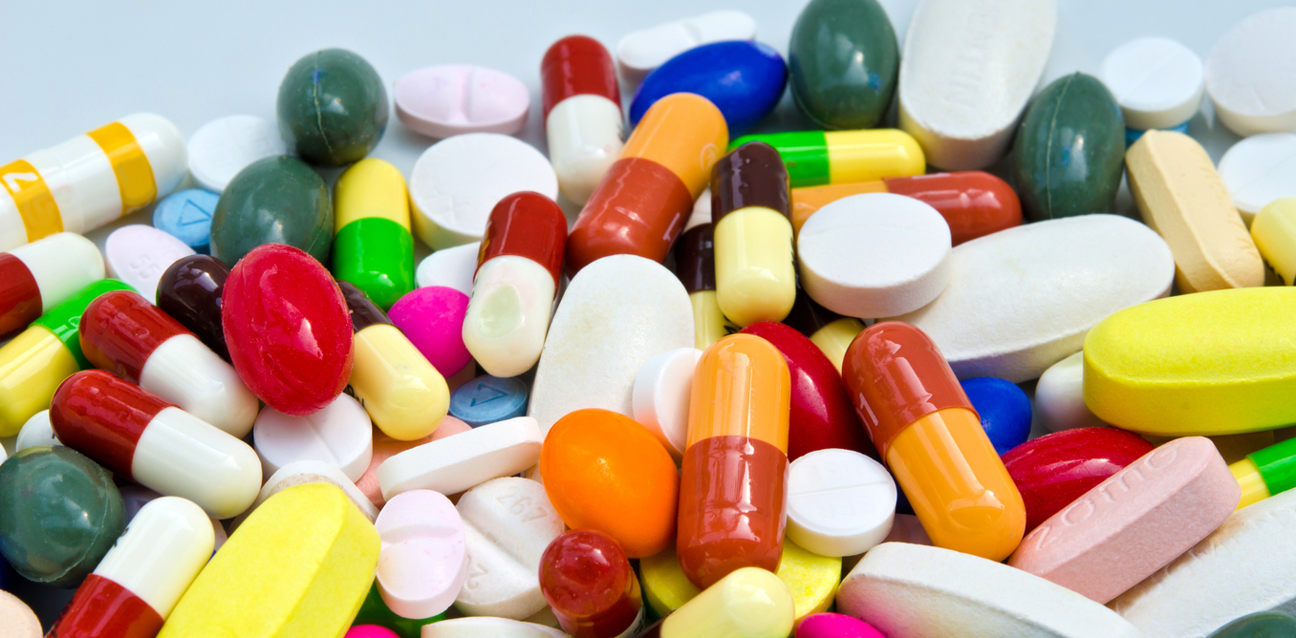
The Drugs that are leading to the drug mortality rate in Scotland
Morgan Jo Tonner
This Photo by Unknown Author is licensed under CC BY-ND

Slide 2
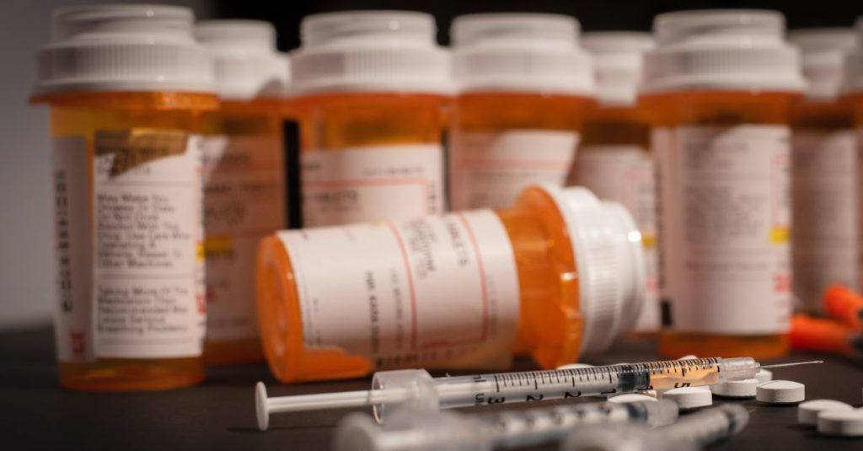
What is a Drug and different drug types
Medicine or Substance that has a physiological effect on you
Ingesting into body ways
Swallowing
Inhaling
Injecting
Effect on Thinking and Judgement
Risk to health problems
Addiction
Serious problem – cancer or death
3 different types
Simulant’s
Depressant
Hallucinogens
Effect on central nervous system
2 sub-categories
Legal
Illegal
This Photo by Unknown Author is licensed under CC BY-ND

Slide 3
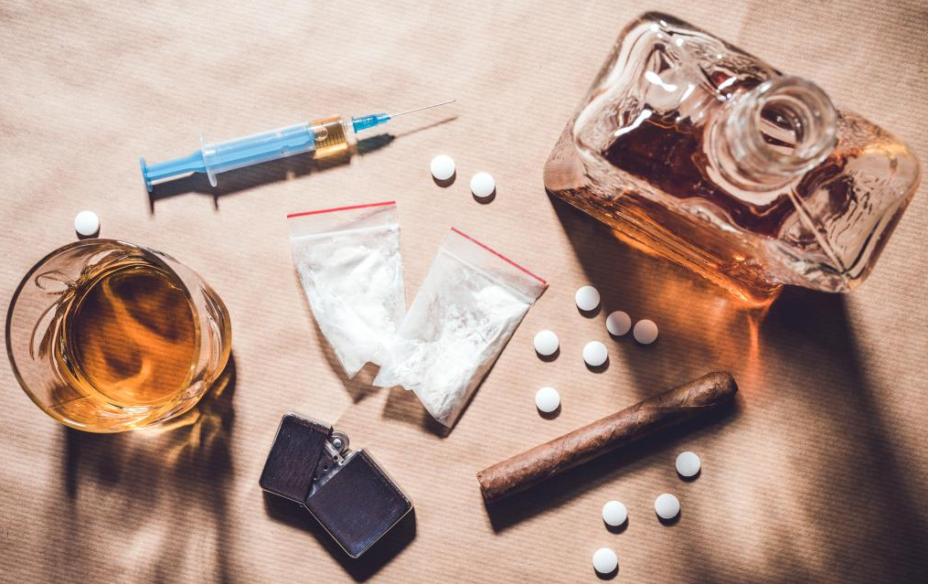
Punishment for Offences and Addiction and Help
3 different class for offences
A
B
C
Offences
Taking
Carrying
Suppling
Making
Common Problem and unable to control if not treated
Associated with
Drugs
Alcohol
Smoking
Gambling
Affect both physical and mental
It is just like any other health problem
Speak to
GP
Family Member
Friends
Treatment is offer on the NHS

Slide 4
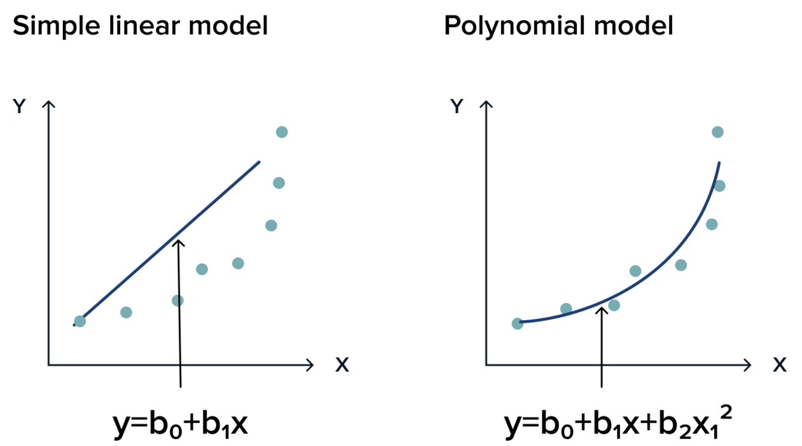


Linear and Polynomial Regression
Model the relationship between a predictor and a response variable.
Simple Linear Regression
$$y= β_{0}+ β_{1}x+ ε$$
Polynomial Regression degree two
$$y= β_{0}+ β_{1}x+ β_{2}x^{2}+ ε$$
$$β_{i}=model parameters i=0,1,2$$
$$ε=standard error$$

Slide 5
Aim and Objectives
To compare the trends of drug-induced mortality occurrences among different drugs in Scotland from 2008 to 2020,
See what drugs cause the most deaths in Scotland.
Estimating trends with year and drugs to variables.
Look at legal and illegal drugs to see if the illegal drug causes more deaths than legal.

Slide 6
Data Sets
Data was collected by the National Record of Scotland
Recorded over 24 years (from 1996 to 2020)
Sub-setting the data by drug-related deaths and implicated cause of death between 2008 to 2020
Response Variable: Death Number by drug (per year)
13 drugs within the datasets

Slide 7
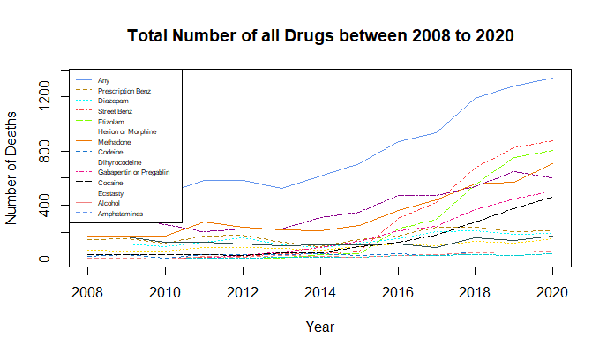
All drugs
Most deaths in 2020 – Street Benzodiazepines
Most deaths in 2008 – Heroin and Morphine
Lowest deaths in 2020 – Ecstasy
Lowest death in 2008 - Etizolam

Slide 8
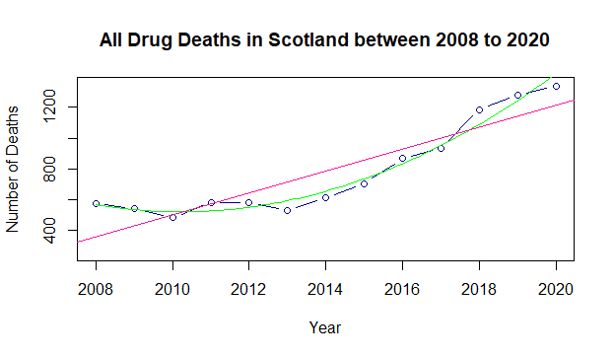
Model for all drug deaths
Linear Regression does not best fit
Polynomial Regression best fits data
Decrease from 2008 to 2010 and from 2011 to 2013
Increase from 2014 until 2020

Slide 9
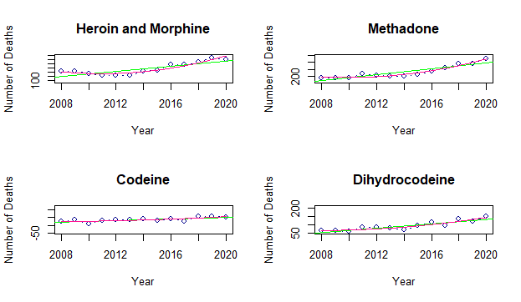
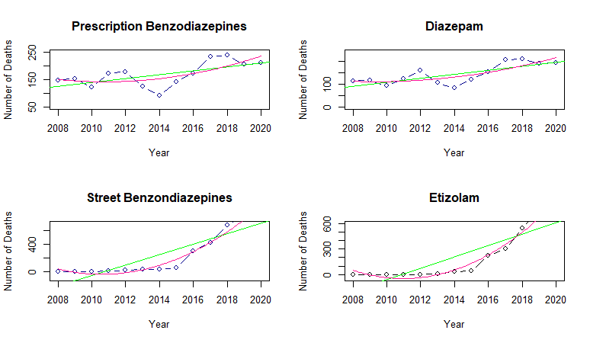
Model
Benzodiazepines and Opioids drugs
Linear Regression does not best fit all the drug data
Polynomial Regression best fits

Slide 10
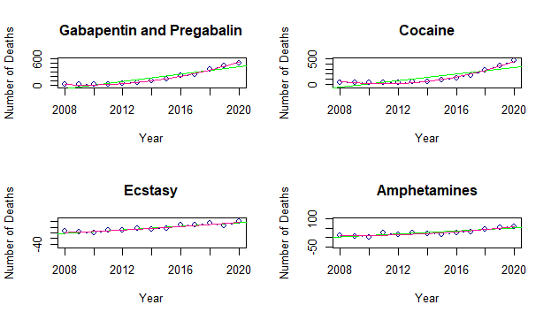
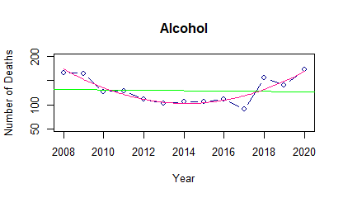
Models
Alcohol, Cocaine, Gabapentin and Pregabalin best fit the polynomial regression
Ecstasy and Amphetamines best fit linear regression

Slide 11
Comparison
Benzodiazepines
Increase over 13-year
Illegal drug have caused more deaths
All fit polynomial regression model
Opioids
Fluctuation over the 13-years with increase in recent years
Illegal drugs have caused more deaths
All fit polynomial regression model
Substance
Increase in some drugs but not all
Legal drugs have caused more deaths
Not a many deaths in this category to the others
Three of the drugs fit polynomial other two fit linear regression model

Slide 12
Scottish Government National Mission
National Mission Announced by Nicola Sturgeon in January 2021
To reduce drug related deaths and harms in Scotland
Aim to help, save and improve lives throughout Scotland
£50 million support fund per year for the next 5 years
Happen so far:
£18 million fund on support
More access to support
Target :
£32 million for front-line work
More digital presence

Slide 13
Conclusion
Increase in drug deaths over the last 13-years
Best Fitted model – Polynomial Regression
Illegal causes more deaths than legal ones
93% drug deaths in Scotland last year there was more than one drug present
The hope the national mission will reduce deaths
Strengths:
Trusted Source
Statistical Technique
Limitations:
Only 13 years and 13 drugs
Death Certificate being corrected
Further Development
Mixed-Effect Model

Slide 14
Thank you for Listening!!! Any Questions???
This Photo by Unknown Author is licensed under CC BY-ND

